Slide 1

The Impact of Taxes and Social Spending on Inequality and Poverty in Argentina, Bolivia, Brazil, Mexico, Peru and Uruguay: An Overview
Nora Lustig
Tulane University; nonresident CGD and IAD
LASA
Washington, DC, May 31, 2013

Slide 2
Papers form part of Tulane Univ and Inter-American Dialogue’s Commitment to Equity project (CEQ)
Special issue: Lustig, Pessino and Scott. Editors. Public Finance Review (forthcoming)
  Argentina: Nora Lustig and Carola Pessino
  Bolivia: George Gray Molina, Wilson Jimenez, Veronica Paz and Ernesto Yañez
  Brazil: Sean Higgins and Claudiney Pereira
  Mexico: John Scott
  Peru: Miguel Jaramillo
  Uruguay: Marisa Bucheli, Nora Lustig, Maximo Rossi and Florencia Amabile

Slide 3
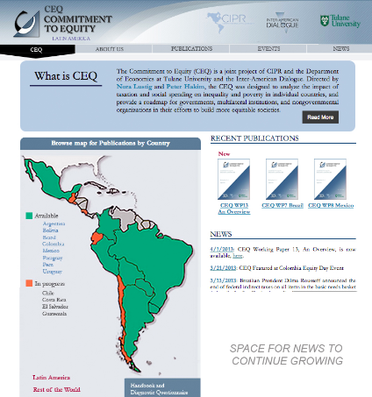
www.commitmentoequity.org

Slide 4
Methodology: Standard Incidence Analysis
Pre-tax/pre-transfer income of unit h, or I_{h}
Taxes/transfers programs T_{i}
“Allocators” of program i to unit h, or S_{ih} (or the share of tax/program i borne/received by unit h)
Then, post-tax/post-transfer income of unit h (Y_{h}) is:
Y_{h} = I_{h} - ∑_{i} T_{i}S_{ih}

Slide 5
Standard Fiscal Incidence Analysis
Pre-tax and benefits incomes
Allocators of taxes and benefits
  personal income and consumption taxes
  social spending: cash transfers and in-kind transfers (education and health)
  Consumption subsidies
Post-tax and benefits incomes
Countries (yr of Survey): Argentina (2009), Bolivia (2007), Brazil (2009), Guatemala (2009), Mexico (2008), Peru (2009), Uruguay (2009), Paraguay (2010)

Slide 7
Results
Wide variation among countries in:
  policy choices (or outcomes of political processes?)
  impact of those choices on income redistribution and poverty reduction

Slide 8
Government size varies greatly in Latin America
Government spending is around 40 percent of GDP in Argentina and Brazil—similar to that of some European nations with larger welfare states
…while it is only around 20 percent in Mexico and Peru

Slide 9
Budget Size and Composition
Primary and Social Spending as % of GDP
Notes:
Size matters but is not destiny. Uruguay showed was number 2 in terms of redistribution and number 1 in terms of poverty reduction but its budget size is close to Mexico´s.
In Peru, fiscal space, however, may be a restriction.

Slide 10
Redistributive Impact Heterogeneous
Taxes and transfers reduce inequality by nontrivial amounts in Argentina, Brazil, and Uruguay, less so in Mexico, and relatively little in Bolivia and Peru
Argentina, Bolivia, Mexico, Peru and Uruguay start from similar Market Income Gini’s but end in very different places with Final Income
Brazil has the highest Market Income Gini by several orders of magnitude but ends up with a lower Final Income Gini than Bolivia and Peru
Although Bolivia has a larger state, it redistributes very little while Uruguay redistributes a great deal

Slide 11
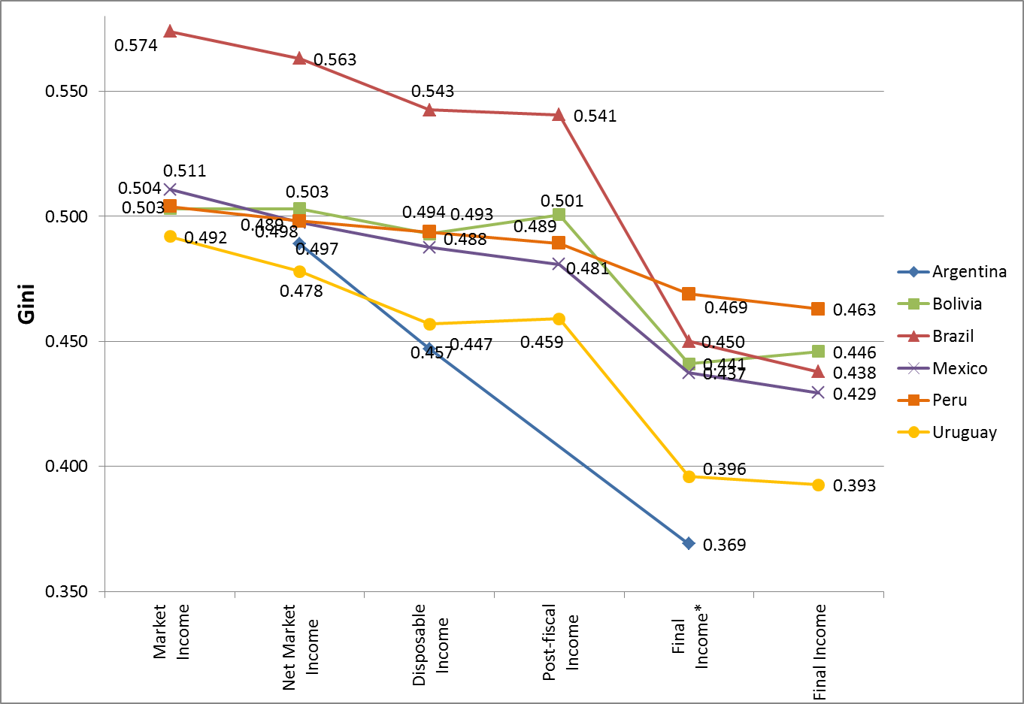
REDISTRIBUTION
Tracking the Gini coefficient from Market to Final Income

Slide 12
Direct Taxes Progressive but Underutilized
Personal income tax varies from around five percent of GDP in Uruguay to nearly zero in Bolivia
In all countries in which they exist, direct taxes are progressive, but because direct taxes are a small percentage of GDP almost everywhere, their redistributive impact is small

Slide 13
Gini Before and After Direct Taxes

Slide 14
Cash Transfers Powerful Redistributive Mechanism only when Targeted and of Significant Magnitude
Cash transfers reduce extreme poverty by more than 60 percent in Uruguay and Argentina…
….but only by 7 percent in Peru, which spends too little on cash transfers to achieve much poverty reduction
Notes:
Most important program in Argentina is the pension moratorium, a ‘one-time’ program only that will be phased-out as those born before the eligibility date die out

Slide 15
Headcount: Before and After Cash Transfers

Slide 16
Poverty Reduction: Brazil and Mexico
Brazil and Mexico have similar GDP/capita and although Brazil starts with a significantly higher poverty rate, they have a similar post cash transfers rate
Brazil has a larger state and spends more than Mexico on cash transfers: coverage among extreme poor in Brazil is over 90% while it is less than 70% in Mx
Poverty reduction in Brazil could be enhanced with better targeting of cash transfers or by expanding cash transfers that are targeted to the poor
Poverty reduction in Mexico could be enhanced by expanding cash transfers that are targeted to the poor

Slide 17
Bolivia spends five times more in cash transfers than Peru (as a share of GDP) but…
…because funds are not targeted to the poor, the amount of redistribution and poverty reduction has been limited: it is only slightly higher than in Peru

Slide 18
Peru’s Juntos, although quite effective because of its fine targeting, achieves very limited poverty and inequality reduction because the scale of the program is small:
  coverage of extreme poor is below 60 percent and per capita transfer is low (compared to poverty gap)

Slide 19
Coverage of Direct Cash Transfers

Slide 20
“Leakages” of Direct Cash Transfers
(Percent going to poor and nonpoor)

Slide 21
Indirect Taxes and Poverty
In Brazil and Bolivia, indirect taxes wipe out most of the effect of direct transfers, and poverty is almost the same after as before taxes and cash transfers.
In contrast, in Mexico, indirect taxes and subsidies reduce poverty further, because exemptions and informality allow the poor to pay little in the form of indirect taxe

Slide 22
Headcount Ratio Before and After Indirect Taxes

Slide 23
Public spending on education and health is a powerful equalizer

Slide 24
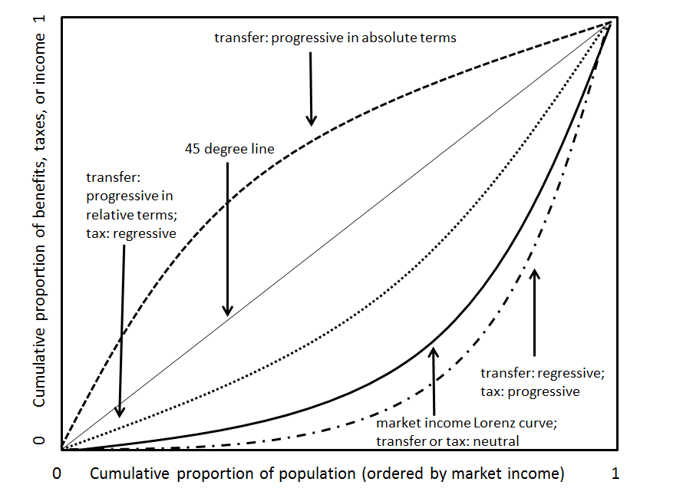
Defining Progressive/Regressive
Taxes and Transfers

Slide 25
Progressivity
Kakwani Index for Taxes: Red= regressive

Slide 26
Direct and Indirect Taxes as % of GDP

Slide 27
Progressivity
Concentration Coefficients for Transfers
Green= progressive in abs terms

Slide 28
Reduction in inequality with respect to Market Income Gini coefficient, Social Spending, and Redistributive Effectiveness

Slide 29
Fiscal Incidence Indicators: Winners and Losers
Who bears the burden of taxes and receives the benefits from cash transfers?
Fiscal incidence by decile and socio-economic groups
Impoverishment: Fiscal mobility matrix
Horizontal equity indicators

Slide 30
Incidence of Taxes and Cash Transfers
Net Change in Income after Direct and Indirect Taxes and Transfers by Decile

Slide 32
In sum…
Taxes and transfers reduce inequality and poverty by nontrivial amounts in Argentina, Brazil, and Uruguay, less so in Mexico and relatively little in Bolivia and Peru.
Personal income tax varies from around five percent of GDP in Uruguay to nearly zero in Bolivia.
In all countries in which they exist, direct taxes are progressive, but because direct taxes are a small percentage of GDP almost everywhere their redistributive impact is small.

Slide 33
In sum…
Cash transfers have reduced extreme poverty by more than 60 percent in Uruguay and Argentina but only by seven percent in Peru, which spends too little on cash transfer to achieve much poverty reduction
Bolivia spends five times more than Peru (as a share of GDP) but because funds are not targeted to the poor, the amount of redistribution and poverty reduction has been limited. It is only slightly higher than Peru.

Slide 34
In sum…
In Brazil and Bolivia, indirect taxes wipe out most effect of direct transfers, and poverty is almost the same after as before taxes and cash transfers.
In contrast, in Mexico poverty after indirect taxes and subsidies is lower because the poor pay little in the form of indirect taxes due to exemptions and informality.
.Public spending on education and health is more equalizing than cash transfers in all the countries.

Slide 35
In sum…
The largely positive redistributive picture of Argentina, Brazil and Uruguay hides some unpleasant facts.
For instance, about 16 percent of Brazilian social spending goes to tertiary education, mostly benefitting the five percent of the population with incomes above US$50 per day.
Uruguay, too, allocates subsidies to upper income students.
In Argentina, progressive cash transfers are substantially less than indirect (and regressive) subsidies to agricultural producers, airlines and other transportation sectors, manufacturing industries, and energy companies. Argentina’s sharp rise of public spending during the 2000s has been increasingly financed by distortionary taxes and unorthodox and unsustainable revenue-raising mechanisms.

Slide 36
THANK YOU

Slide 37


